Slide 1
Tn5-based WGBS
Verda Agan

Slide 2
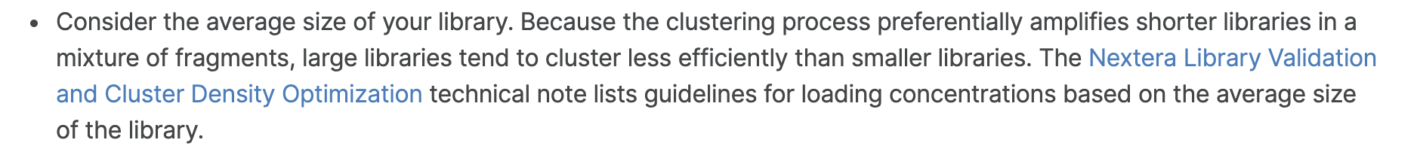
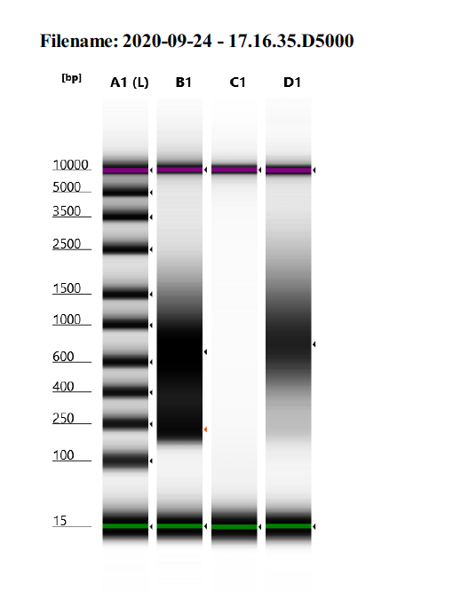
After BS treatment, fragments of the sequencing library should should have a size range of 200-600 bp with a peak at about 300-400 bp.
B1: Here, we obtained DNA fragments in the 200-600 bp range, but there were more 200 and 600 bp fragments than 300/400 bp fragments.
How can we improve fragmentation?
Start with less input DNA in order to get a smaller library size. I used 50 ng this first time.
“T-WGBS is particularly suited for low input DNA amounts and has been optimized for 10-30 ng of human or mouse input DNA.” (Nature Protocols)
Increase tagmentation time (and/our amount of enzyme?).
Troubleshoot bisulfite conversion step.
See next slide.
Previously used EZ DNA Methylation Kit and didn’t see cytosine to uracil conversion. Try again?
D1: Here, peak is ~700 bp. How can we skew distribution towards smaller fragment sizes?
Notes:
https://support.illumina.com/bulletins/2016/06/how-to-achieve-more-consistent-cluster-density-on-illumina-sequencing-platforms.html

Slide 3
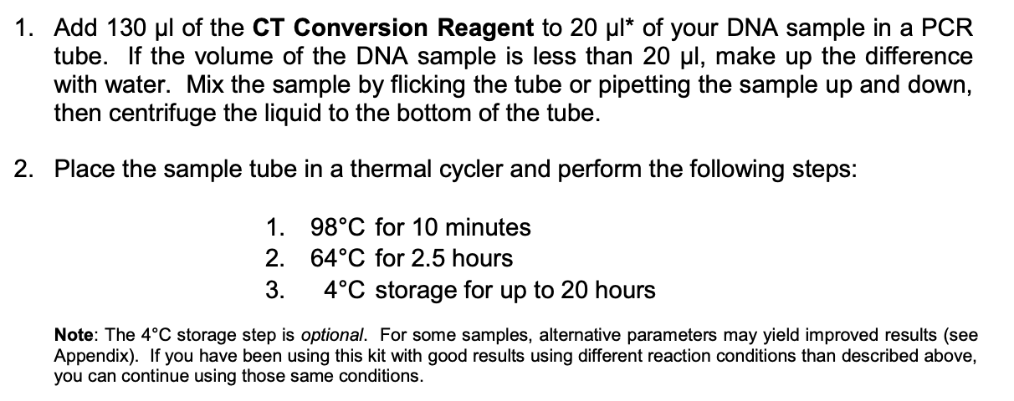
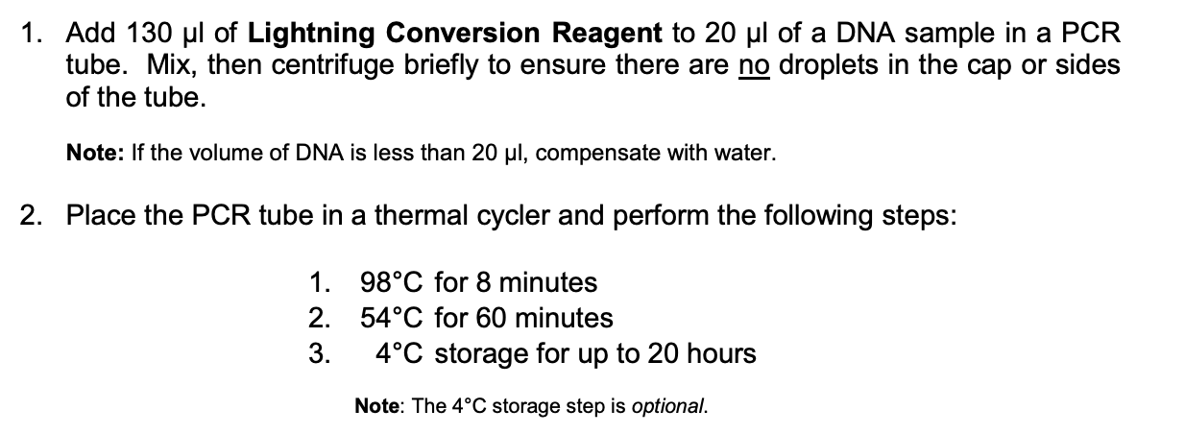
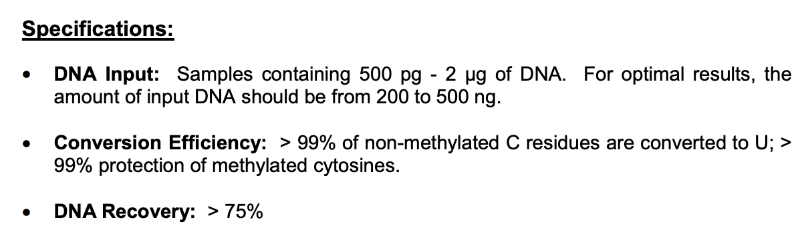
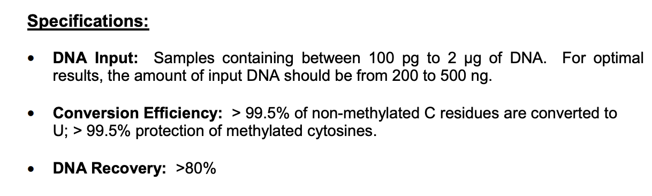
Troubleshooting BS conversion step
EZ DNA Methylation Gold Kit
EZ DNA Lightning Kit
Longer incubation time and lower heat/variable cycling results in longer fragment sizes and less DNA degradation. Alternative options also suggest longer DNA fragments will be produced.
Shorter incubation time and higher heat results in shorter fragment sizes and more DNA degradation (Lindsey tested).
Notes:
Lightning kit (Lightning Conversion Reagent) uses ammonium bisulfite; gold uses sodium bisulfite (CT conversion reagent). Sodium bisulfite is less damaging

Slide 4
Troubleshooting BS conversion step
My options are to:
A) Test different amounts of input DNA (10, 25, 30, etc..)
B) Use EZ DNA Methylation Kit.
C) Use EZ DNA Methylation Gold Kit but use the thermocycler conditions recommended in the EZ DNA Methylation Kit.

Slide 5
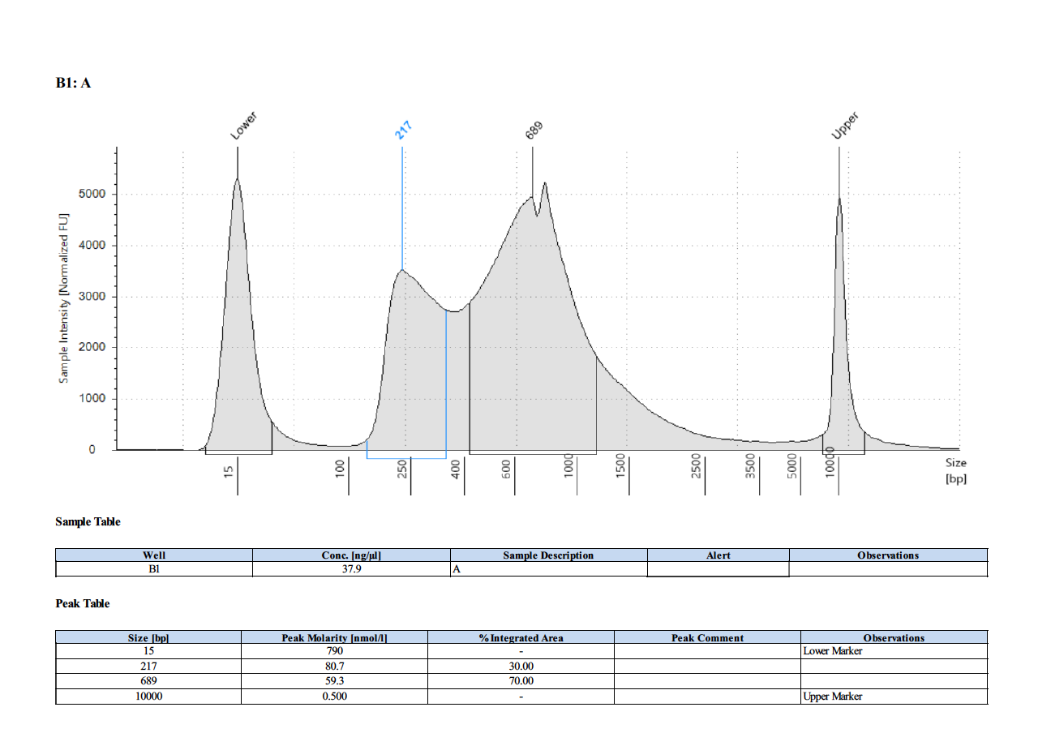

Slide 6
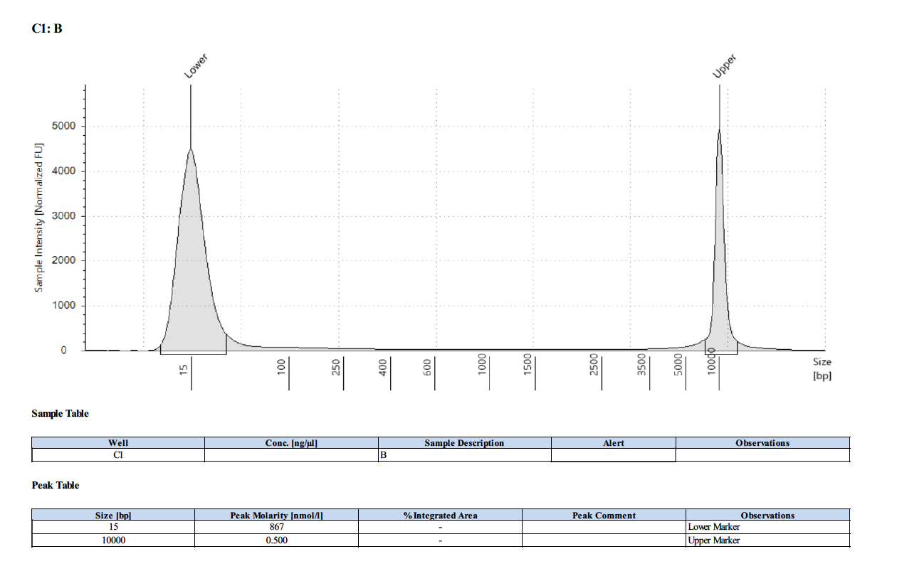

Slide 7
